Slide 1
Verizon SOI
NLP on call transcripts

Slide 2




Presentation Overview
NLP Algorithm Features
Standardize and Scalable algorithm
Customer Insights
Algorithm Deep-dive

Slide 3





Summary
Algorithm was built on international call transcript data from Oct’18 to Dec’18.
Algorithm ran on 10 months of call transcripts – From Sep’18 to May’19
Accuracy achieved by the algorithm – 70%
Algorithm can be extended across multiple domains (Billing, Accounts, Plan & Data)
Key Descriptive Insights
50% (30k)
of phone setting calls are coming within
48 hours of travel
8.6% (52k)
of callers are calling for network coverage in the visiting country
12%
Majority of phone settings calls are from Canada and Mexico
8.6% (52k)
of callers are calling on behalf of their family for Travel Pass Enquiry
Verizon confidential and proprietary. Unauthorized disclosure, reproduction or other use prohibited.
Notes:
Key Insights based on 5 months of data
40% of 28K device setting calls who travelled and called in the same month per annum are within 48 hours of travel between December’ 18 and May’19.
For Canada vs Mexico for the above insight, 60 % of the 3.6K are calls from Canada and 40% of the 5.3K calls are from Mexico.
40% of the customer enquiries on Cruise(5K) and Travel Pass(36K) occur in 48 hours of website visit. Given that customer travels and calls in the same month and website visit occurs within 7 days prior to travel.
8% (52K) of callers are calling for Network coverage in the visiting country
9% (59K) of callers are calling on behalf of their family for Travel Pass Enquiry

Slide 4
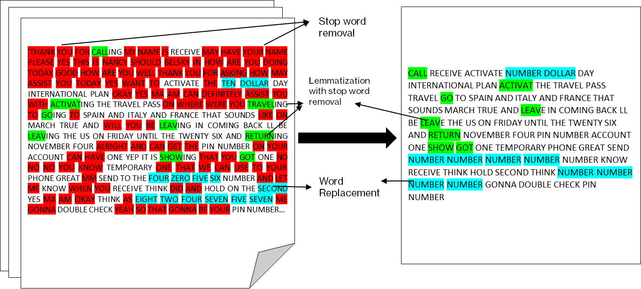
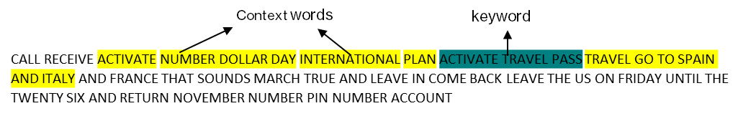
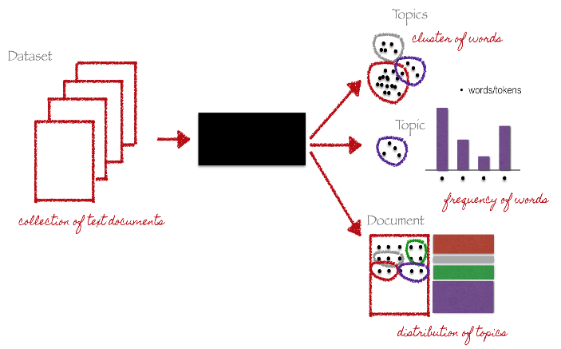
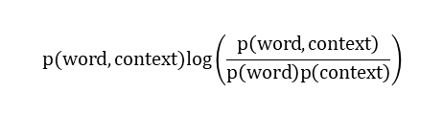
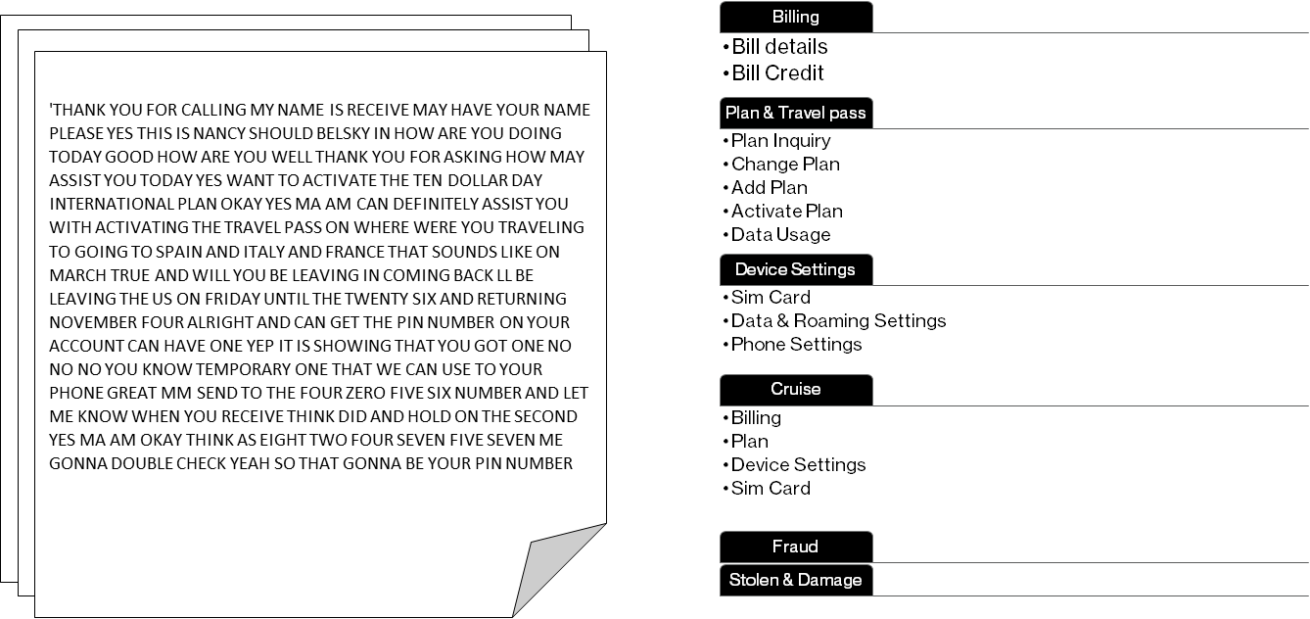
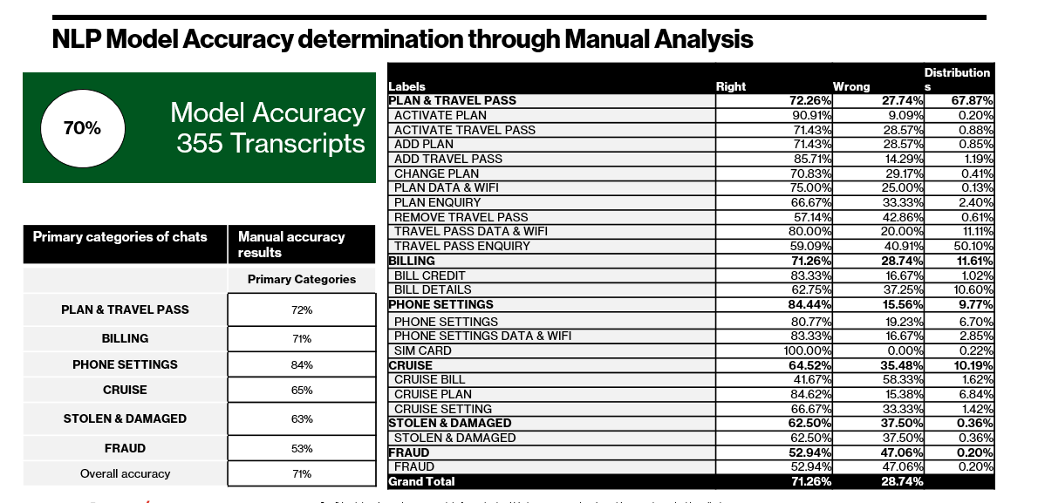
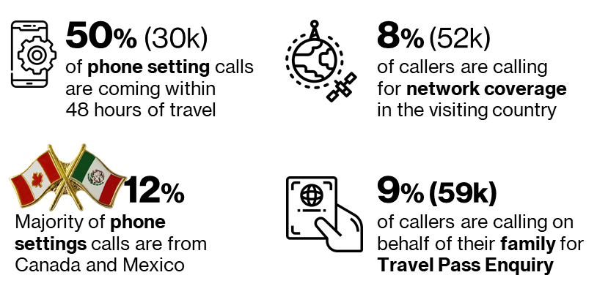
NLP Framework to Identify Call Transcript Categories
Text Cleaning
Corpus of Keywords using Mutual Information Theory
Topic modeling to discover hidden semantic structures
Chat Transcript
Category Mapping
Accuracy Calculation And Validation Details
Insights Generation

Slide 5
Very Scalable NLP Algorithm For Other Business Areas
Only 1 Stage of Manual Intervention
Keyword Extraction
Topic Modeling, Category Identification
Bag of
Words
Standardized Code
Manual Intervention
Call Transcript
Text
Cleaning
NLP Algorithm
Run
Key word corpus creation
Category Mapping
Accuracy validation*

Slide 6

Final NLP Category And Subcategory
Dec 18 - May 19
International Calls
(0.6 M)
Plan & Travel Pass
(48%, 294K)
Billing
(16%, 96k)
Cruise
(9%, 55K)
Phone Settings
(9%, 55K)
Family
(8.6 %, 52K)
Coverage
(8.6 %, 52K)
Plan Data & WIFI
(10.07%, 61k)
Bill Credit
(1.6%, 9.8k)
Cruise Bill
(1.7%, 10K)
Device Settings
(6%, 38k)
Travel Pass Enquiry
(34%, 204k)
Bill Details
(14%, 85k)
Cruise Plan
(6%, 37K)
Data & WIFI
(2.6%, 15k)
Fraud
(0.42%, 2.5k)
Remove TP
(0.24%, 1.4k)
Device Payment
(0.27%, 1.6k)
Setting
(1.2%, 7.3K)
SIM Card
(0.26%, 1.5k)
Lost & Stolen
(0.3%, 1.8k)
Add Plan/TP
(2%, 12k)
SIM Card
(0.03%, 153)
Activate Plan/TP
(1.13%, 6.9)
Change Plan
(0.5%, 3k)
Discount
(0.74%, 4.5 k)
Verizon confidential and proprietary. Unauthorized disclosure, reproduction or other use prohibited.
Verizon confidential and proprietary. Unauthorized disclosure, reproduction or other use prohibited.

Slide 7
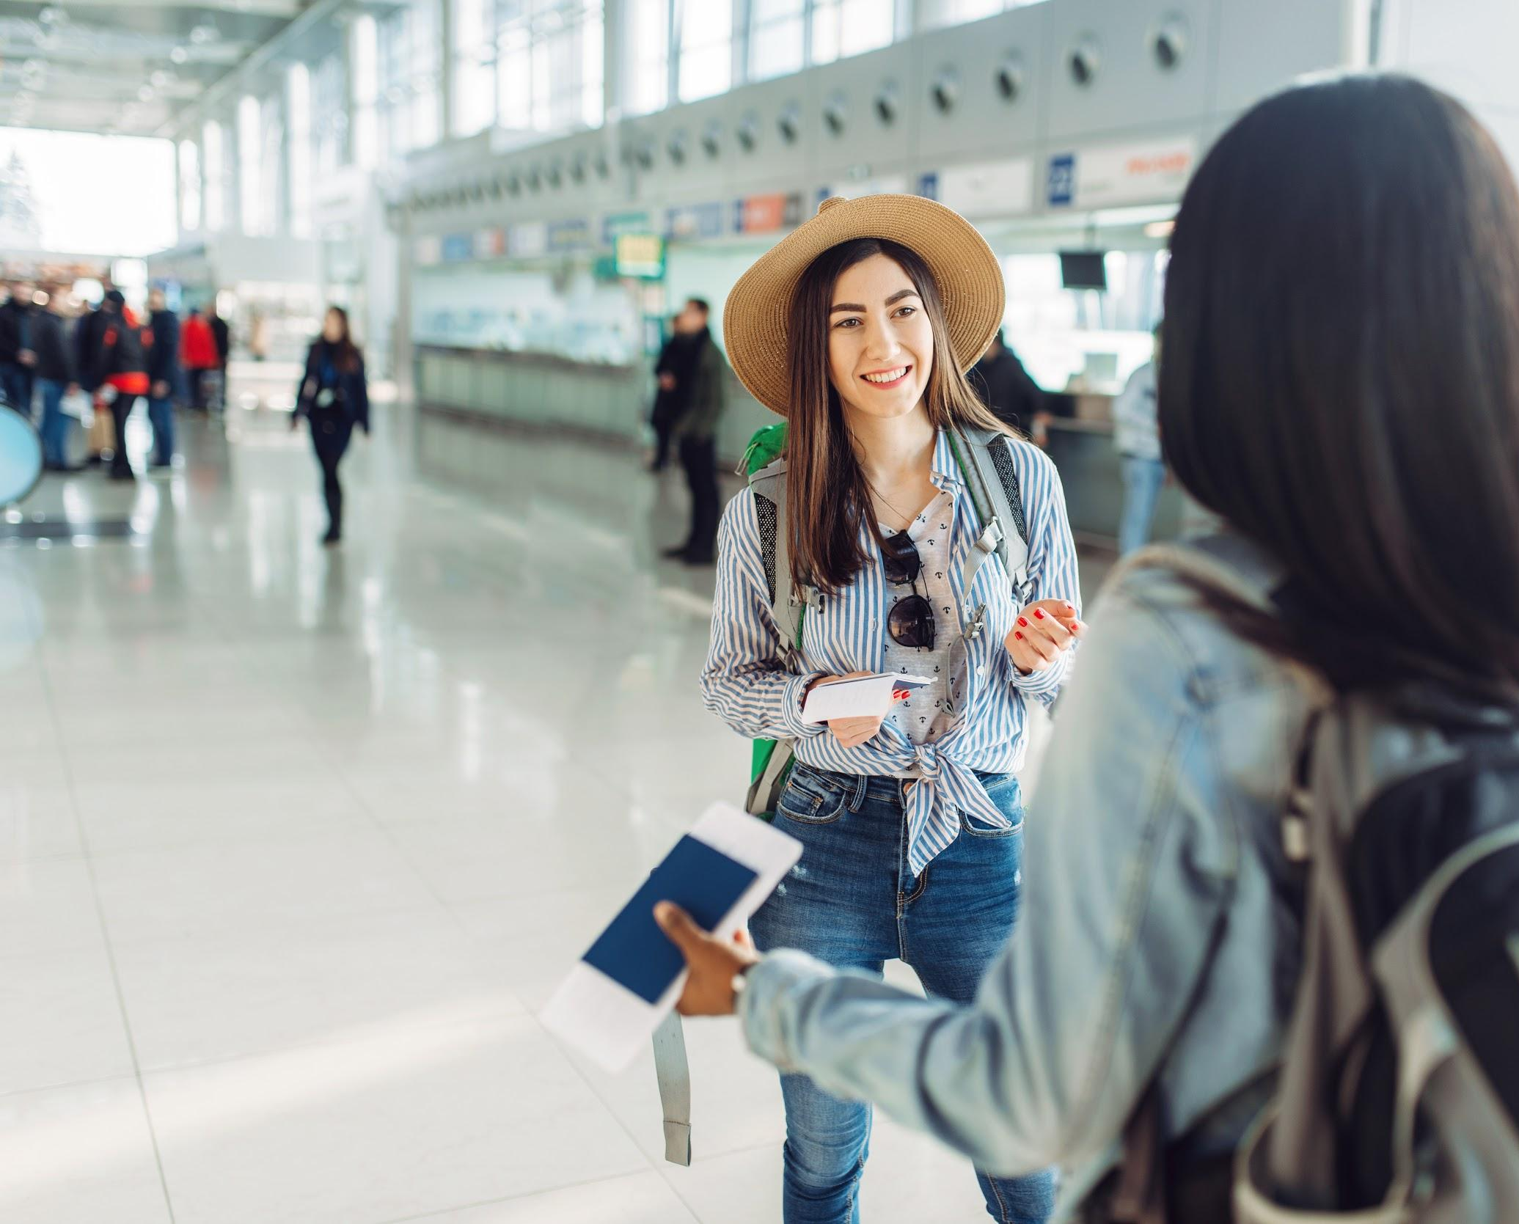
International Call Intent Categories
Call Before Travel
Call During/ After Travel
Plan/Tp Enquiry
(169,361, 37.20%)
Bill Details
(55,031, 36.10%)
Bill Details
(52,727, 11.60%)
Plan/Tp Enquiry
(30,290, 19.90%)
Plan/Tp Data & Wifi
(47,718, 10.50%)
Plan /Tp Data & Wifi
(12,907, 8.50%)
Coverage
(35,644, 7.80%)
Phone Settings
(10,292, 6.80%)
Family
(34,049, 7.50%)
Family
(9,938, 6.50%)
Observations
On average 73 % travelers calling before travel Billing related call volume significantly high after travel
Cruise Plan
(32,792, 7.20%)
Coverage
(7,985, 5.20%)
Verizon confidential and proprietary. Unauthorized disclosure, reproduction or other use prohibited.

Slide 8


NLP Approach: Text Cleaning
'THANK YOU FOR CALLING MY NAME IS RECEIVE MAY HAVE YOUR NAME PLEASE YES THIS IS NANCY SHOULD BELSKY IN HOW ARE YOU DOING TODAY GOOD HOW ARE YOU WELL THANK YOU FOR ASKING HOW MAY ASSIST YOU TODAY YES WANT TO ACTIVATE THE TEN DOLLAR DAY INTERNATIONAL PLAN OKAY YES MA AM CAN DEFINITELY ASSIST YOU WITH ACTIVATING THE TRAVEL PASS ON WHERE WERE YOU TRAVELING TO GOING TO SPAIN AND ITALY AND FRANCE THAT SOUNDS LIKE ON MARCH TRUE AND WILL YOU BE LEAVING IN COMING BACK LL BE LEAVING THE US ON FRIDAY UNTIL THE TWENTY SIX AND RETURNING NOVEMBER FOUR ALRIGHT AND CAN GET THE PIN NUMBER ON YOUR ACCOUNT CAN HAVE ONE YEP IT IS SHOWING THAT YOU GOT ONE NO NO NO YOU KNOW TEMPORARY ONE THAT WE CAN USE TO YOUR PHONE GREAT MM SEND TO THE FOUR ZERO FIVE SIX NUMBER AND LET ME KNOW WHEN YOU RECEIVE THINK
Stop words
"utterances":[{"channel": "channel_1","utterance":"THANK YOU FOR CALLING MY NAME IS A RECEIVE MAY I HAVE YOUR NAME PLEASE.","utteranceStartTime":0.9,"utteranceConfidence":0.94},{"channel": "channel_2","utterance":"YES THIS . IS NANCY SHOULD BELSKY.","utteranceStartTime":5.42,"utteranceConfidence":0.86},{"channel": "channel_1","utterance":"IN HOW . ARE YOU DOING TODAY.","utteranceStartTime":8.46,"utteranceConfidence":0.8},{"channel": "channel_2","utterance":"I'M GOOD . HOW ARE YOU.","utteranceStartTime":10.96,"utteranceConfidence":0.8},{"channel": "channel_1","utterance":"WELL THANK . YOU FOR ASKING HOW MAY I ASSIST YOU TODAY.","utteranceStartTime":12.28,"utteranceConfidence":0.92},{"channel": "channel_2","utterance":"YES I . WANT TO ACTIVATE . THE TEN DOLLAR DAY INTERNATIONAL . PLAN ..","utteranceStartTime":16.0,"utteranceConfidence":0.7},{"channel": "channel_1","utterance":"OKAY YES . MA'AM I CAN DEFINITELY ASSIST YOU WITH ACTIVATING THE TRAVEL PASS ON WHERE WERE YOU TRAVELING TO.","utteranceStartTime":21.6,"utteranceConfidence":0.87},{"channel": "channel_2","utterance":"GOING TO . SPAIN . AND ITALY AND FRANCE.","utteranceStartTime":28.88,"utteranceConfidence":0.77},{"channel": "channel_1","utterance":"THAT SOUNDS . LIKE ON MARCH TRUE AND . WILL YOU BE LEAVING IN COMING BACK.","utteranceStartTime":32.8,"utteranceConfidence":0.77},{"channel": "channel_2","utterance":"I'LL BE . LEAVING THE US ON . FRIDAY UNTIL . THE TWENTY SIX AND . RETURNING . NOVEMBER . FOUR ..","utteranceStartTime":40.76,"utteranceConfidence":0.57},{"channel": "channel_1","utterance":"ALRIGHT AND . CAN I GET THE PIN NUMBER ON YOUR ACCOUNT.","utteranceStartTime":54.91,"utteranceConfidence":0.85},{"channel": "channel_2","utterance":"CAN I . HAVE ONE.","utteranceStartTime":59.97,"utteranceConfidence":0.7},{"channel": "channel_1","utterance":"YEP IT . IS SHOWING THAT YOU GOT ONE.","utteranceStartTime":69.82,"utteranceConfidence":0.82},{"channel": "channel_3","utterance":"NO NO . NO YOU KNOW.","utteranceStartTime":72.7,"utteranceConfidence":0.83},{"channel": "channel_1","utterance":"TEMPORARY ONE . THAT WE CAN USE TO YOUR PHONE GREAT . MM SEND TO THE FOUR ZERO FIVE SIX NUMBER AND . LET ME KNOW WHEN YOU RECEIVE.","utteranceStartTime":75.9,"utteranceConfidence":0.84},{"channel": "channel_2","utterance":"I THINK . I DID AND HOLD ON THE SECOND.","utteranceStartTime":99.23,"utteranceConfidence":0.85},{"channel":
Input text with JSON format. Length of the chat~9000 words & symbols
Removed JSON format. Length of chat~3000 words.
Word replacement

Slide 9

NLP Approach: Text Cleaning
CALL NANCY BELSKY NUMBER DOLLAR INTERNATIONAL PLAN ACTIVATE TRAVEL PAS TRAVEL COUNTRY COUNTRY COUNTRY MONTH LEAVE LEAVE FRIDAY NUMBER RETURN MONTH PIN NUMBER ACCOUNT SHOW TEMPORARY SEND NUMBER PIN NUMBER TRAVEL GRAHAM FAMILY TELL PRE SOUND CHARGE MINUTE TRAVEL CHARGE NUMBER DOLLAR CHARGE CONNECT WIFI CYCLE CHARGE LOCATION BASE CURRENT PLAN SET SEND EMAIL DIAL INSTRUCTION SET AUTOMATICALLY CONNECT NETWORK EMAIL FILE YAHOO TRAVEL PAS AUTOMATICALLY MAIL HOP WEATHER IDAHO PLAN FOOD WORK EVENT WANT NUMBER ACTIVE QUESTION STRAIGHT SOUND
Removed stop words and replaced with common words
Created a list of ~1000 stop word from the corpus.
CALLING NANCY BELSKY NUMBER DOLLAR INTERNATIONAL PLAN ACTIVATING TRAVEL PASS TRAVELING COUNTRY COUNTRY COUNTRY MONTH LEAVING LEAVING FRIDAY NUMBER RETURNING MONTH PIN NUMBER ACCOUNT SHOWING TEMPORARY SEND NUMBER PIN NUMBER TRAVEL GRAHAM FAMILY TOLD PRE SOUNDED CHARGED MINUTES TRAVEL CHARGED NUMBER DOLLARS CHARGED CONNECTED WIFI CYCLE CHARGE LOCATIONS BASED CURRENT PLAN SET SEND EMAIL DIALING INSTRUCTIONS SETTING AUTOMATICALLY CONNECT NETWORK EMAIL FILES YAHOO TRAVEL PASS AUTOMATICALLY MAILED HOPING WEATHER IDAHO PLAN FOOD WORK EVENT WANTED NUMBER ACTIVE QUESTIONS STRAIGHT SOUNDS
Lemmatized the text to convert words to base form. Final word count~80 words.
Verizon confidential and proprietary. Unauthorized disclosure, reproduction or other use prohibited.

Slide 10
NLP Approach: Keyword Extraction
Co-occurrence matrix for the top 10 frequent words and phrases based on 10 chats.
The p(word) is the sum over all the context words.
p(BILL)= 0.07+0.03+0.02+0.05+0.04+0.02=0.22
Keyword
CALL NANCY BELSKY NUMBER DOLLAR INTERNATIONAL PLAN ACTIVATE TRAVEL PASS TRAVEL COUNTRY COUNTRY COUNTRY MONTH LEAVE LEAVE FRIDAY NUMBER RETURN MONTH PIN NUMBER ACCOUNT SHOW TEMPORARY SEND NUMBER PIN NUMBER TRAVEL GRAHAM
Context words
 | BILL | CHARGE | DATA | MONTH | PLAN | TEXT | P (context)
BILL | 0.07 | 0.03 | 0.02 | 0.05 | 0.04 | 0.02 | 0.22
CHARGE | 0.03 | 0.02 | 0.02 | 0.02 | 0.02 | 0.01 | 0.12
DATA | 0.02 | 0.02 | 0.03 | 0.02 | 0.03 | 0.02 | 0.14
MONTH | 0.05 | 0.02 | 0.02 | 0.05 | 0.04 | 0.02 | 0.20
PLAN | 0.04 | 0.02 | 0.03 | 0.04 | 0.05 | 0.02 | 0.20
TEXT | 0.02 | 0.01 | 0.02 | 0.02 | 0.02 | 0.03 | 0.12
P (word) | 0.22 | 0.12 | 0.14 | 0.20 | 0.20 | 0.12 | 1.00
Verizon confidential and proprietary. Unauthorized disclosure, reproduction or other use prohibited.

Slide 11
NLP Approach: Keyword Extraction
 | BILL | CHARGE | DATA | MONTH | PLAN | TEXT | Keyword Score
BILL | 0.00 | 0.09 | 0.00 | 0.43 | 0.01 | 0.00 | 0.54
CHARGE | 0.09 | 0.00 | 0.00 | 0.02 | 0.00 | 0.01 | 0.12
DATA | 0.00 | 0.00 | 0.00 | 0.00 | 0.01 | 0.07 | 0.08
MONTH | 0.43 | 0.02 | 0.00 | 0.00 | 0.06 | 0.00 | 0.52
PLAN | 0.01 | 0.00 | 0.01 | 0.06 | 0.00 | 0.00 | 0.09
TEXT | 0.00 | 0.01 | 0.07 | 0.00 | 0.00 | 0.00 | 0.08
p(BILL) Keyword= 0.00+0.09+0.00+0.43+0.01+0.00=0.54
The dependency between the word and the context is given by mutual information
MI values form the word embedding of the corpus and the vector operations over the words are possible
Keyword score is the measure of connectedness with all other words in the corpus
The extraction algorithm can be scaled to a large set of keywords across multiple domains
MI = ∑p (word, context) x log | ( | p (word, context) | )
 |  | p (word) p (context)

Slide 12

NLP Approach: Topic Modeling
Billing
Bill details
Bill Credit
Device Payment
Plan & Travel pass
Plan Inquiry
Change Plan
Add Plan
Activate Plan
Data Usage
Device Settings
Sim Card
Data & Roaming Settings
Phone Settings
Cruise
Billing
Plan
Device Settings
Sim Card
Fraud
Stolen & Damage
Topic Modeling is performed to find possible classes from the call transcripts.
Transcripts
THANK YOU FOR CALLING MY NAME IS RECEIVE MAY HAVE YOUR NAME PLEASE YES THIS IS NANCY SHOULD BELSKY IN HOW ARE YOU DOING TODAY GOOD HOW ARE YOU WELL THANK YOU FOR ASKING HOW MAY ASSIST YOU TODAY YES WANT TO ACTIVATE THE TEN DOLLAR DAY INTERNATIONAL PLAN OKAY YES MA AM CAN DEFINITELY ASSIST YOU WITH ACTIVATING THE TRAVEL PASS ON WHERE WERE YOU TRAVELING TO GOING TO SPAIN AND ITALY AND FRANCE THAT SOUNDS LIKE ON MARCH TRUE AND WILL YOU BE LEAVING IN COMING BACK LL BE LEAVING THE US ON FRIDAY UNTIL THE TWENTY SIX AND RETURNING NOVEMBER FOUR ALRIGHT AND CAN GET THE PIN NUMBER ON YOUR ACCOUNT CAN HAVE ONE YEP IT IS SHOWING THAT YOU GOT ONE NO NO NO YOU KNOW TEMPORARY ONE THAT WE CAN USE TO YOUR PHONE GREAT MM SEND TO THE FOUR ZERO FIVE SIX NUMBER AND LET ME KNOW WHEN YOU RECEIVE THINK DID AND HOLD ON THE SECOND YES MA AM OKAY THINK AS EIGHT TWO FOUR SEVEN FIVE SEVEN ME GONNA DOUBLE CHECK YEAH SO THAT GONNA BE YOUR PIN NUMBER WHENEVER YOU HAVE TO CALL IN AND SO NOW DO YOU KNOW HAVE THE TRAVEL
Transcript Breakup
0.0130*CHARGE+0.0088*MONTH+0.0088*PLAN+0.0065*COUNTRY+0.0050*WIFI+0.0043*EMAIL+0.0040*PAS+0.0037*SET+0.0034*TRAVEL PAS+0.0033*INTERNATIONAL+0.0028*WORK+0.0023*CONNECT+0.0021*ACTIVATE+0.0020*ACCOUNT+0.0016*NETWORK+0.0016*CYCLE+0.0016*FAMILY+0.0015*MINUTE+0.0015*SHOW+0.0014*AUTOMATICALLY
Verizon confidential and proprietary. Unauthorized disclosure, reproduction or other use prohibited.

Slide 13
NLP Approach: Assignation
Scoring Assignation
Positional Assignation
Sum (number of keyword appearances x keyword importance)
Sum (2*Bill*Score of Bill+3*Month*Score of Month+……………..)
'THANK YOU FOR CALLING MY NAME IS RECEIVE MAY HAVE YOUR NAME PLEASE YES THIS IS NANCY SHOULD BELSKY IN HOW ARE YOU DOING TODAY GOOD HOW ARE YOU WELL THANK YOU FOR ASKING HOW MAY ASSIST YOU TODAY YES WANT TO ACTIVATE THE TEN DOLLAR DAY INTERNATIONAL PLAN OKAY YES MA AM CAN DEFINITELY ASSIST YOU WITH ACTIVATING THE TRAVEL PASS ON WHERE WERE YOU TRAVELING TO GOING TO SPAIN AND ITALY AND FRANCE THAT SOUNDS LIKE ON MARCH TRUE AND WILL YOU BE LEAVING IN COMING BACK LL BE LEAVING THE US ON FRIDAY UNTIL THE TWENTY SIX AND RETURNING NOVEMBER FOUR ALRIGHT AND CAN GET THE PIN NUMBER ON YOUR ACCOUNT CAN HAVE ONE YEP IT IS SHOWING THAT YOU GOT ONE NO NO NO YOU KNOW TEMPORARY ONE THAT WE CAN USE TO YOUR PHONE GREAT MM SEND TO THE FOUR ZERO FIVE SIX NUMBER AND LET ME KNOW WHEN YOU RECEIVE THINK
*positional assignation is done on the cleaned chat for chunks of 50 words each.
x 1
Transcripts | Billing | Plan & Travel Pass | Phone Settings | Cruise
Transcript 1 | 0.019 | 0.022 | 0.008 | 0.004
Transcript 2 | 0.046 | 0.059 | 0.001 | 0.005
Transcript 3 | 0.062 | 0.023 | 0.002 | 0.001
Transcript 4 | 0.012 | 0.027 | 0.009 | 0.329
Transcript 5 | 0.049 | 0.033 | 0.004 | 0.002
x ½
x ⅓
This scoring mechanism gives higher weightage based on the importance of keywords.
Each category is compared based on the scores achieved and the category with max score is assigned to the transcript
This help in providing the consistent results compared to other models as these weights capture the intent.
Verizon confidential and proprietary. Unauthorized disclosure, reproduction or other use prohibited.

Slide 14
NLP Validation: Statistical Validation & Post Model Analysis
Transcripts | Billing | Plan & Travel Pass | Phone Settings | Cruise
Transcript 1 | 0.019 | 0.022 | 0.008 | 0.004
Transcript 2 | 0.046 | 0.059 | 0.001 | 0.005
Transcript 3 | 0.062 | 0.023 | 0.002 | 0.001
Transcript 4 | 0.012 | 0.027 | 0.009 | 0.329
Transcript 5 | 0.049 | 0.033 | 0.004 | 0.002
Test for independence between the classes are also conducted and the results implied that Plan and Travel Pass are to be combined.

Slide 15
NLP Model Accuracy Determination Through Manual Analysis
Model Accuracy 355 Transcripts
Primary categories of chats | Manual accuracy results
 | Primary Categories
Plan & Travel Pass | 72%
Billing | 71%
Phone Settings | 84%
Cruise | 65%
Stolen & Damaged | 63%
Fraud | 53%
Overall Accuracy | 71%
Labels | Right | Wrong | Distributions
Plan & Travel Pass | 72.26% | 27.74% | 67.87%
Activate Plan | 90.91% | 9.09% | 0.20%
Activate Travel Pass | 71.43% | 28.57% | 0.88%
Add Plan | 71.43% | 28.57% | 0.85%
Add Travel Pass | 85.71% | 14.29% | 1.19%
Change Plan | 70.83% | 29.17% | 0.41%
Plan Data & Wifi | 75.00% | 25.00% | 0.13%
Plan Enquiry | 66.67% | 33.33% | 2.40%
Remove Travel Pass | 57.14% | 42.86% | 0.61%
Travel Pass Data & Wifi | 80.00% | 20.00% | 11.11%
Travel Pass Enquiry | 59.09% | 40.91% | 50.10%
Billing | 71.26% | 28.74% | 11.61%
Bill Credit | 83.33% | 16.67% | 1.02%
Bill Details | 62.75% | 37.25% | 10.60%
Phone Settings | 84.44% | 15.56% | 9.77%
Phone Settings | 80.77% | 19.23% | 6.70%
Phone Settings Data & Wifi | 83.33% | 16.67% | 2.85%
Sim Card | 100.00% | 0.00% | 0.22%
Cruise | 64.52% | 35.48% | 10.19%
Cruise Bill | 41.67% | 58.33% | 1.62%
Cruise Plan | 84.62% | 15.38% | 6.84%
Cruise Setting | 66.67% | 33.33% | 1.42%
Stolen & Damaged | 62.50% | 37.50% | 0.36%
Stolen & Damaged | 62.50% | 37.50% | 0.36%
Fraud | 52.94% | 47.06% | 0.20%
Fraud | 52.94% | 47.06% | 0.20%
Grand Total | 71.26% | 28.74% | 100.00%
70%

Slide 16
Comparison of NLP Model with Verint Results
57k Verint Transcripts
Tested with
Primary categories of chats | Manual accuracy results
 | Primary Categories
Plan & Travel Pass | 65%
Billing | 43%
Phone Settings | 36%
Cruise | 97%
Stolen & Damaged | 32%
Fraud | 49%
Overall Accuracy | 65%
Secondary Categories of Transcripts | Incorrect | Correct | Distribution
Billing | 56.14% | 43.86% | 11.61%
Bill Credit | 77.83% | 22.17% | 1.02%
Bill Details | 54.05% | 45.95% | 10.60%
Cruise | 3.18% | 96.82% | 10.19%
Activate Plan | 0.00% | 100.00% | 0.01%
Activate Travel Pass | 96.67% | 3.33% | 0.05%
Add Plan | 1.79% | 98.21% | 0.10%
Add Travel Pass | 96.72% | 3.28% | 0.11%
Change Plan | 7.14% | 92.86% | 0.02%
Cruise Bill | 2.48% | 97.52% | 1.62%
Cruise Plan | 1.43% | 98.57% | 6.84%
Cruise Setting | 1.84% | 98.16% | 1.42%
Cruise Sim Card | 14.29% | 85.71% | 0.02%
Fraud | 51.11% | 48.89% | 0.20%
Phone Settings | 63.92% | 36.08% | 9.77%
Phone Settings | 53.15% | 46.85% | 6.70%
Phone Settings Data & Wifi | 88.93% | 11.07% | 2.85%
Sim Card | 68.97% | 31.03% | 0.22%
Plan & Travel Pass | 34.77% | 65.23% | 67.87%
Stolen & Damaged | 67.11% | 32.89% | 0.36%
Grand Total | 35.06% | 64.94% | 100.00%

Slide 17

Next Steps
1
Deployment of NLP algorithm for International callers in production environment.
2
Model Improvements based on feedback.
step
step
Monetize Use cases based on NLP.
4
Extending the current NLP model across Domains like Accessories, Billing etc.
3
step
step

Slide 18
APPENDIX

Slide 19
Verint Call Topic Mapping with NLP
Phone Settings
CD TRBL Data Connection
CD INTL How to Dial/Device Settings
CD TRBL Device Settings & Issues
CD TRBL Voice
CD TRBL Data Connection/Browser
CD TRBL Apps, Features & Services
CD TRBL Messaging
CD TRBL Voicemail
Device Settings
CD INTL How to Dial
CD INTL iDial
CD TRBL Network Signal Issues
CD EQIP Setup/Activation Issues
CD EQIP Dual SIM
CD TRBL Network Extenders
Plan& Travel Pass
CD USAG Manage Usage
CD INTL Travel Pass
CD INTL International Plan Feature Options
CD PLAN Review Current Plan
CD PLAN Add/Change
CD ACCT Add A Line/New Activation
Fraud
CD ACCT Spam/Spoof Calling
CD ACCT Fraud
CD BILL Bill Explanation
CD ACCT Billing System Password
CD BILL ELEU Discount
CD BILL Bill Format
CD PYMT Bank Bill Pay
CD BILL Dispute Charges
CD BILL Specific Charge Inquiry
CD BILL Bill Copy
CD PYMT Make a Payment
CD BILL Credit Request
CD BILL Cycle Date
CD BILL Balance Inquiry
CD UPGR Bill to Account Review
Cruise
CSP
Billing

Slide 20
Verint Accuracy Calculation Logic
Excluding generic Travel Pass Enquiry Classes. Considering the classes which does not fall into anyone of the NLP primary category other than TP & Plan
Total Transcripts (57k)
Only Belong to TP& Plan Feature Options (23k)
Transcripts for Evaluation (34k)
Correct Classification (22k)
Accuracy 65%
Including generic Travel Pass Enquiry Classes
Total Transcripts (57k)
Correct Classification (46k)
Accuracy 81%
Transcripts which belongs to only “CD INTL Travel Pass” and “CD INTL International Plan Feature Options” and does not belong to any other call topic category are considered as a general case of TP enquiry and are exempted from the accuracy calculation to measure the model performance on the remaining specific categories. Inclusion of the generic categories increased the accuracy. To avoid biasness due to the skewness of the data towards a particular category 23k transcripts have been left out while accuracy calculation.

Slide 21
Verint Accuracy Calculation Steps
Step-1
Identifying and mapping the NLP categories with the Verint.
CD TRBL Data Connection
CD INTL How to Dial/Device Settings
CD TRBL Device Settings & Issues
CD TRBL Voice
CD TRBL Data Connection/Browser
CD TRBL Apps, Features & Services
CD TRBL Messaging
CD TRBL Voicemail
Device Settings
CD INTL How to Dial
CD INTL iDial
CD TRBL Network Signal Issues
CD EQIP Setup/Activation Issues
CD EQIP Dual SIM
CD TRBL Network Extenders
CD USAG Manage Usage
CD INTL Travel Pass
CD INTL International Plan Feature Options
CD PLAN Review Current Plan
CD PLAN Add/Change
CD ACCT Add A Line/New Activation
Plan& Travel Pass
Phone Settings
Fraud
CD ACCT Spam/Spoof Calling
CD ACCT Fraud
Cruise is not present in the verint call topics.Identifying the transcripts with the “Cruise key Word” search assuming that if the cruise keyword is present the transcript belongs to “cruise” and then matched the same with the algorithm output.
Cruise
Billing
CD BILL Bill Explanation
CD ACCT Billing System Password
CD BILL ELEU Discount
CD BILL Bill Format
CD PYMT Bank Bill Pay
CD BILL Dispute Charges
CD BILL Specific Charge Inquiry
CD BILL Bill Copy
CD PYMT Make a Payment
CD BILL Credit Request
CD BILL Cycle Date
CD BILL Balance Inquiry
CD UPGR Bill to Account Review
21

Slide 22
Accuracy Calculation Steps Contd….
Step-2
Filtering out the Verint categories which has the following attributes:
CD INTL Travel Pass only.
International Plan Feature Options > CD INTL Travel pass
International Plan Feature options and CD INTL Travel pass along with categories which cannot be mapped to any of the NLP categories.
CD INTL Travel Pass
CD ACCT Notification Letter/Email/Text/Call > CD INTL Travel Pass
CD INTL Travel Pass > CD INTL International Plan Feature Options
CD INTL Travel Pass > CD ACCT Call Message Block
CD INTL Travel Pass > CD UPGR Eligibility Inquiry
CD INTL Travel Pass > CD ACCT Informational
CD INTL Travel Pass > CD ACCT Insurance (TEC/TMP)
CD ACCT Insurance (TEC/TMP) > CD UPGR Certified Like New Replacement > CD INTL Travel Pass
List of Not Mapped categories
Filtering out the ““CD INTL Travel Pass” and “International Plan Feature of options” ensures a less biasness towards the Plan & Travel Pass enquiry category as a majority of the Verint flow has the same.

Slide 23
Key opportunities identified for reducing predictive models
Opportunity 1: 19K calls have Potential to migrate to Self Serve channel.
These customers purchased plan before hand, visited website and still called for confirmation of travel pass
Opportunity 2: 7.5K calls are sales calls – Potential to reduce by sending the right message by creating a predictive model
Customers visited the website, did not purchase the plan before hand and called customer care to purchase the plan.
Opportunity 3 - Model: Propensity to purchase a travel plan
Huge opportunity to sell travel pass to customer who are not purchasing travel pass now
37%, 4M travelers, last 5 months didn’t purchase a plan and 14% of them visited digital channel before travel
Even if 1/3rd of the 14% purchase a travel pass of $5, it will result in $2.4M incremental revenue per annum
Notes:
Opportunity 3 - Model: Propensity to purchase a travel plan

Slide 24
Customer Insights

Slide 25
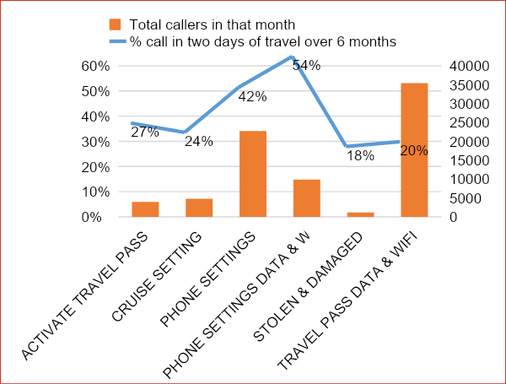
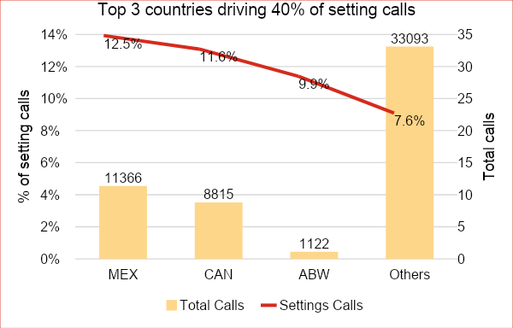
NLP Insights: Phone Settings calls – 52K
Evaluated based on same month traveled and called.
Average of 12% of calls coming from Mex, Can and AWB are travelers calling for phone settings – highest in any category
50% of setting calls are coming within 48 hours of travel.
December’18-May’19

Slide 26



Background
Algorithm built was carried on international call transcript data from Oct’18 to Dec’18.
Removed stop words.
Removed the names/country names which are not relevant.
Lemmatization of words using parts of speech.
Relevant Keyword extraction using Mutual Information Theory
Text Classification with Bag of Words.
Position assignation to classify categories.
The validation / analysis is done on international call transcript data on Dec’18
Data Description
Data Processing
Approach
Data Description

Slide 27
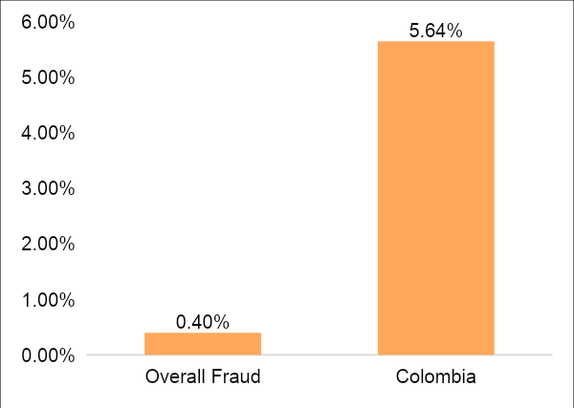
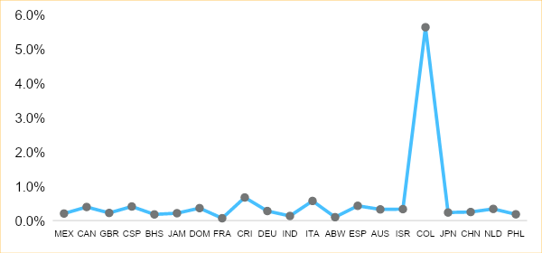
Fraud Calls Analysis
Total number of calls for Colombia for the month of December’18 is 1330.
The Fraud distribution for the country of Colombia is significantly higher than the overall fraud calls received. Colombia has the highest percentage of fraud calls among the countries which are significant contributors in terms of total calls received by Verizon.

Slide 28
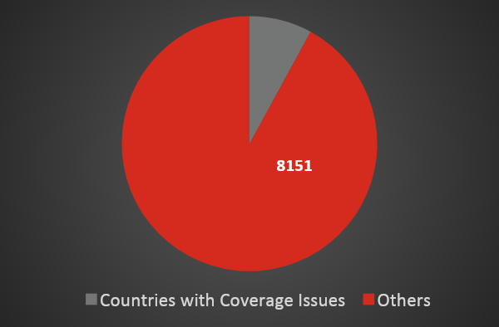
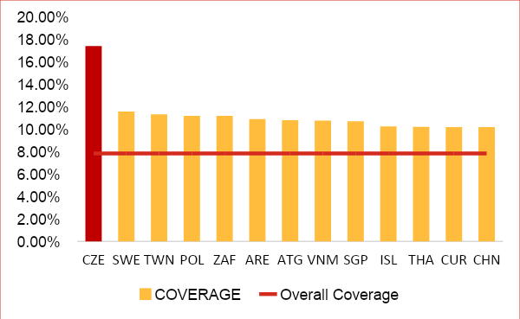
Coverage Analysis
704
3511
Overall
Coverage calls
7.83%
5344
Total calls received: 113k
Coverage Calls: 8855 (7.83%)
The countries are selected with a threshold of coverage>=10% and total number of calls >=200 to avoid selecting countries getting less significant amount of calls for Verizon.
The above countries accounts for 8% of calls which are made for coverage enquiries. Czech Republic has the highest number of calls which is 10% higher than the overall calls received for coverage enquiry. The issue is particularly observed in the South East Asian countries.

Slide 29
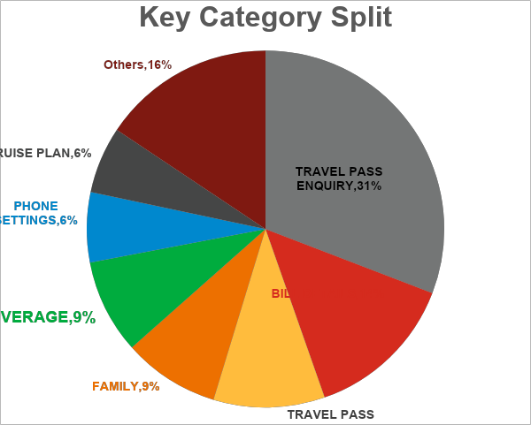
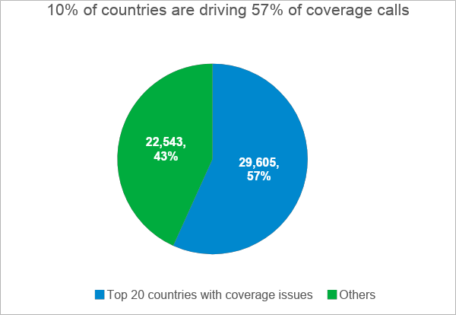
Coverage Analysis
704
3511
5344
The countries are selected with a threshold of coverage>=9% calls for the country and total number of calls >=3500 to avoid selecting countries getting less significant amount of calls
8% (52K) of callers are calling for checking the coverage present in the visitor country.
December’18-May’19

Slide 30

International travel page analysis- 19K calls could have been reduced using right communication
Total calls Before Travel
550K (100%)
Visited Online
Visited Mobile
99K (18%)
151k (28%)
International Page Visited = Yes
International Page Visited = No
Not Purchased Plan
International Page Visited = Yes
International Page Visited = No
128K (23%)
35K (35%)
64K (65%)
27K (18%)
123K (81%)
Purchased Plan Before call
Not Purchased Plan
Purchased Plan after call
Opportunity 2: 7.5K calls are sales calls – potential to reduce by sending the right message by creating a predictive model
19k (19%)
8k(8%)
7.5k (7.5%)
Opportunity 1: 19K calls have Potential to migrate to Self Serve
December’18,Feb’19-May’19
Notes:
Opportunity 1: 19K calls have Potential to migrate to Self Serve
Opportunity 2: 7.5K calls are sales calls – potential to reduce by sending the right message by creating a predictive model

Slide 31
$2.4M potential Opportunity to sell travel pass by predicting propensity to buy
Plan Purchased without Call
(56%,6M)
Travelled
(11M)
(0.6M * $5 per travel pass * 1/3rd up take) =
0.6M*5*1/3 = $1M for 5 months ~ $2.4M per annum
Opportunity to sell travel pass to customers using predictive model for incremental revenue of $2.4M
Visited Online
(14%,0.6M)
International Page Visited
(24%, 0.1M)
Plan Purchased before call
(5%, 0.5M)
Plan Purchased after call
(1.15%, 0.1M)
Called and not purchased 2%,183k
Plan not Purchased
(38%,4M)
December’18,Feb’19-May’19
Notes:
Visits to website
Plan not Purchased
(38%,4M)
Opportunity to sell travel pass to customers using predictive model

